Slide 1
Recursion (CS 1002)
Dr. Muhammad Aleem,
Department of Computer Science,
National University of Computer & Emerging Sciences, Islamabad Campus

Slide 2
Introduction to Recursion
A recursive function is one that calls itself.
void Message(void) { cout << "This is a recursive function.\n"; Message(); }
The above function displays the string "This is a recursive function.\n", and then calls itself.
Can you see a problem with this function?

Slide 3
Recursion
The function is like an infinite loop because there is no code to stop it from repeating.
Like a loop, a recursive function must have some algorithm to control the number of times it repeats.

Slide 4
Recursion : Using Control Condition
void Message(int times) { if (times > 0) { cout << "This is a recursive function.\n"; Message(times ‑ 1); } return; }
The function contains an if/else statement that controls the repetition. For example, if we call the function:
Message(5);
The argument, 5, will cause the function to call itself 6 times.

Slide 5
Recursion : Using Control Condition
void Message(int times) { if (times > 0) // Base case { cout << "This is a recursive function.\n"; Message(times ‑ 1); } return; }
With each recursive call, the parameter controlling the recursion should move closer to the base case
Eventually, the parameter reaches the base case and the chain of recursive calls terminates

Slide 6
void Message(int times) { if (times > 0) { cout << "This is a recursive function.\n"; Message(times ‑ 1);
} return; }
1st call of the function
Value of times: 5
2nd call of the function
Value of times: 4
3rd call of the function
Value of times: 3
4th call of the function
Value of times: 2
This cycle repeats itself until 0 is passed to the function.
5th call of the function
Value of times: 1
6th call of the function
Depth of recursion: 6
Value of times: 0

Slide 7
Program Output
This is a recursive function. This is a recursive function. This is a recursive function. This is a recursive function. This is a recursive function.

Slide 8
What Happens When Called?
Each time a recursive function is called, a new copy of the function runs, with new instances of parameters and local variables being created
As each copy finishes executing, it returns to the copy of the function that called it
When the initial copy finishes executing, it returns to the part of the program that made the initial call to the function
Notes:
See pr14-03.cpp

Slide 9
Types of Recursion
Direct recursion
a function calls itself
Indirect recursion
function A calls function B, and function B calls function A. Or,
function A calls function B, which calls …, which calls function A

Slide 10
Recursive Function
#include <iostream>
using namespace std;
void message(int);
int main() {
message(5);
return 0;
}
//************************************************************
// Definition of function message. If the value in times is *
// greater than 0, the message is displayed and the function *
// is recursively called with the argument times - 1. *
//************************************************************
void message(int times)
{ cout << "message called with " << times
<< " in times.\n";
if (times > 0)
{
cout << "This is a recursive function.\n";
message(times - 1);
}
cout << "message returning with " << times;
cout << " in times.\n";
return;
}
message called with 5 in times.
This is a recursive function.
message called with 4 in times.
This is a recursive function.
message called with 3 in times.
This is a recursive function.
message called with 2 in times.
This is a recursive function.
message called with 1 in times.
This is a recursive function.
message called with 0 in times.
message returning with 0 in times.
message returning with 1 in times.
message returning with 2 in times.
message returning with 3 in times.
message returning with 4 in times.
message returning with 5 in times.

Slide 11
Recursion
To build all recursive functions:
Define the base case(s)
Define the recursive case(s)
Divide the problem into smaller sub-problems
Solve the sub-problems
Combine results to get answer
Sub-problems solved as a recursive call to the same function
Notes:
* Give me some examples
* How many? (more than…)

Slide 12
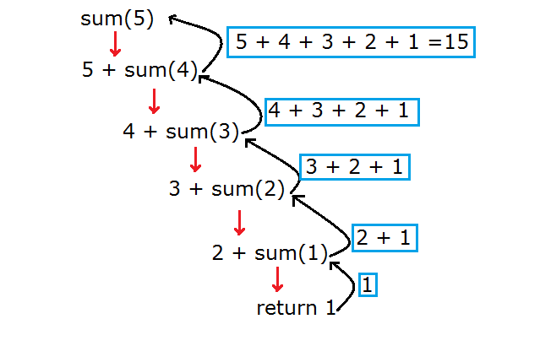
Creating a Sum Function
sum(10) = 10+9+…2+1 = 55

Slide 13
Creating a Sum function (Iterative)
//Our initial total is zero
int total = 0;
//We want the sum from 1 + 2 + ... + 9 + 10
int n = 10;
/* The following for loop will calculate the summation from 1 – n */
for ( int i = 1; i <= n; i++ ) {
total = total + i;
}

Slide 14
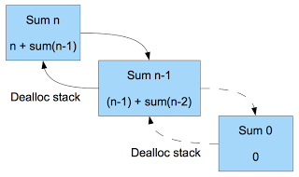
Creating a Sum function (Recursive)
int sum(int n) {
//Return 0 when n is 0
if ( n ==1 )
return 1;
else //recursive call
return n + sum(n-1);
}

Slide 15
The Recursive Factorial Function
The factorial of a non-negative integer n is the product of all positive integers less or equal to n
Factorial of n is denoted by n!
The factorial of 0 is= 1
0 ! = 1
n ! = n x (n-1) x … x 2 x 1 if n > 0

Slide 16
The Recursive Factorial Function
Factorial of n can be expressed in terms of the factorial of n-1
0 ! = 1
n ! = n x (n-1) !
The base case is n = 0
Recursive function:
int factorial(int n)
{
if (n == 0)
return 1;
else
return n * factorial(n-1);
}

Slide 17
Character Search - Recursive
int numChars(char search, char str[], int subscript)
{
if (str[subscript] == '\0')
{
// Base case: The end of the string is reached.
return 0;
}
else if (str[subscript] == search)
{
/* Recursive case: A matching character was found. Return 1 plus the number of times the search character appears in the rest of the string.*/
return 1 + numChars(search, str,subscript+1);
}
else
{
/* Recursive case: A character that does not match the search character was found. Return the number of times the search character appears in the rest of the string. */
return 0+ numChars(search, str, subscript+1);
}
}
#include <iostream>
using namespace std;
// Function prototype
int numChars(char, char [], int);
int main()
{
char array[] = "abcddddef";
/* Display the number of times the letter 'd' appears in the string. */
cout << "The letter d appears "
<< numChars('d', array, 0) << " times.\n";
return 0;
}

Slide 18
Printing a Sequence of Numbers in Reverse
void print(int n) {
if ( n <= 0 )
return; //Base condition
cout << n << " "; //Print number n
print(n-1); //Calls itself with (n-1)
return; //Returns from the function
}
print(3) produces → 3 2 1

Slide 19
Printing a Sequence of Numbers in Ascending Order
Example:
Input Number: 5
Output: 1 2 3 4 5

Slide 20
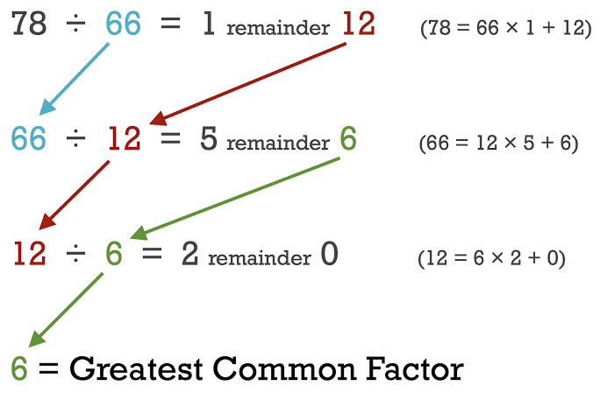
Finding gcd
Notes:
In mathematics, the greatest common divisor (gcd) of two or more integers, which are not all zero, is the largest positive integer that divides each of the integers. For example, the gcd of 8 and 12 is 4.

Slide 21
The Recursive gcd Function
int gcd(int x, int y)
{
if (x % y == 0) //base case
return y;
else
return gcd(y, x % y);
}
Notes:
In mathematics, the greatest common divisor (gcd) of two or more integers, which are not all zero, is the largest positive integer that divides each of the integers. For example, the gcd of 8 and 12 is 4.

Slide 22
Solving Recursively Defined Problems
The natural definition of some problems leads to a recursive solution
Example: Fibonacci numbers:
1, 1, 2, 3, 5, 8, 13, 21, ...
After the starting two numbers, each term is the sum of the two preceding terms
Recursive solution:
fib(n) = fib(n – 1) + fib(n – 2);
Base cases: n == 0, n == 1

Slide 23
Recursion
5th Fib. Number
fib 5
fib 4 + fib 3
fib 3 + fib 2
fib 2 + fib 1
fib 2 + fib 1
fib 1 + fib 0
fib 1 + fib 0
fib 1 + fib 0
= 5
Notes:
* Give me some examples
* How many? (more than…)

Slide 24
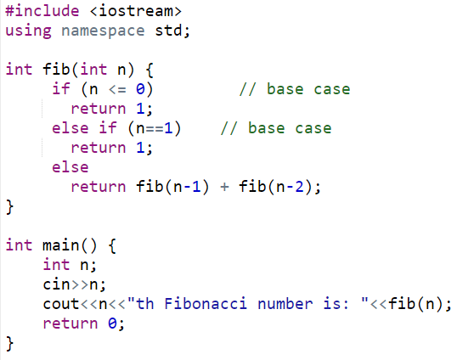
Recursive Fibonacci Function
0;
Notes:
See pr14-06.cpp

Slide 25
Solving Recursively Defined Problems
One of the most famous mathematical recursive algorithms is the Fibonacci sequence.
Fibonacci sequences appear in many places in nature, such as branching of trees, the spiral of shells, the fruitlets of a pineapple, an uncurling fern frond, and the arrangement of a pine cone.

Slide 26
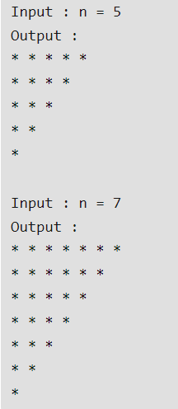
Printing Patterns using Recursion
Notes:
See pr14-06.cpp

Slide 27
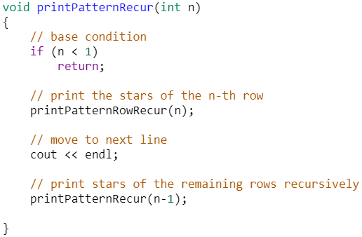
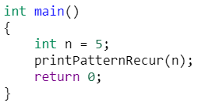
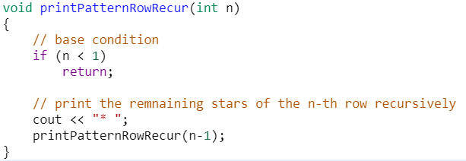
Printing Patterns using Recursion
Code credits: https://www.geeksforgeeks.org/
Notes:
See pr14-06.cpp

Slide 28
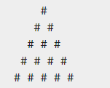
Printing Patterns using Recursion
Input:
Draw a Pyramid of size: 5
Output:
Notes:
See pr14-06.cpp

Slide 29
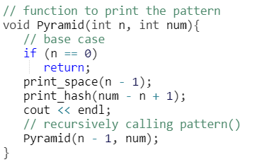
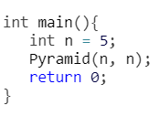
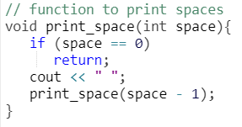
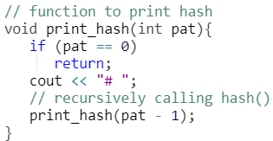
Printing Patterns using Recursion
Code credits: https://www.tutorialspoint.com/
Notes:
See pr14-06.cpp

Slide 30
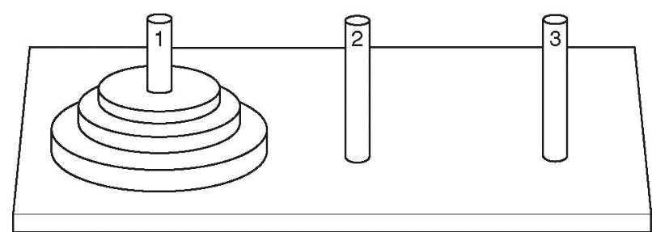
The Towers of Hanoi
Setup: 3 pegs, one has n disks on it, the other two pegs empty. The disks are arranged in increasing diameter:
top→ bottom
Objective: move the disks from peg 1 to peg 3:
only one disk moves at a time
all remain on pegs except the one being moved
a larger disk cannot be placed on top of a smaller disk at any time

Slide 31
The Towers of Hanoi
How it works:
n=1 | Move disk from peg 1 to peg 3. Done.
n=2 | Move top disk from peg 1 to peg 2. Move remaining disk from peg 1 to peg 3. Move disk from peg 2 to peg 3. Done.
Notes:
For N = 1 disk
Total Steps = 1
For N=2 disks
Total steps= 3
For N=3 disks
Total steps= 3 steps (move top 2 disks P1→P2) + 1 step (largest disk P1→P3) + 3 steps (two disks P2→P3)
= 7 Steps

Slide 32
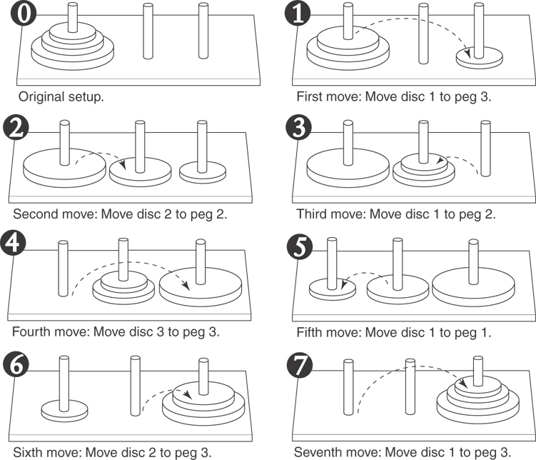
Moving Three Discs
Notes:
For N = 1 disk
Total Steps = 1
For N=2 disks
Total steps= 3
For N=3 disks
Total steps= 3 steps (move top 2 disks P1→P2) + 1 step (largest disk P1→P3) + 3 steps (two disks P2→P3)
= 7 Steps

Slide 33
Outline of Recursive Algorithm
If n==0, do nothing (base case)
If n>0, then
Move the topmost n-1 disks from peg1 to peg2
Move the n^{th} disk from peg1 to peg3
Move the n-1 disks from peg2 to peg3
end if
Notes:
See pr14-09.cpp

Slide 34
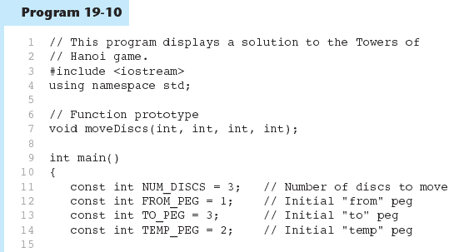

Slide 35
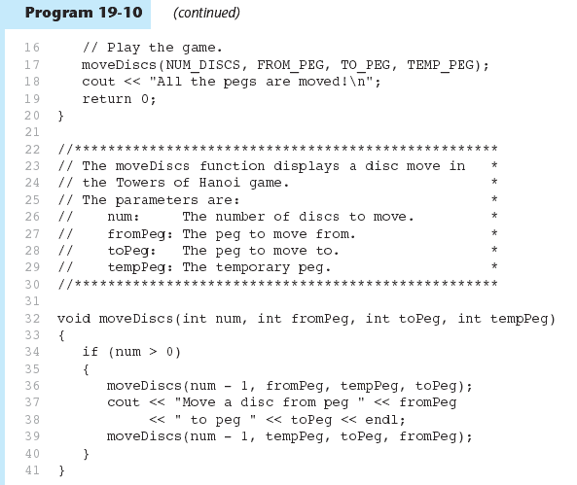

Slide 36
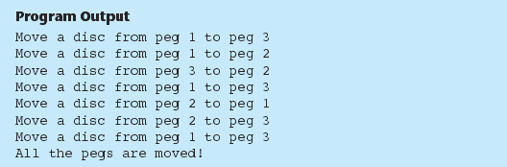

Slide 37
Recursion VS. Iteration
Benefits (+), disadvantages(-) of Recursive Implementation
Natural formulation of solution to certain problems
Results in shorter, simpler functions
May not execute very efficiently
Benefits (+), disadvantages(-) for iterative Implementation
Executes more efficiently than recursion
May not be as natural as recursion for some problems

